Slide 1
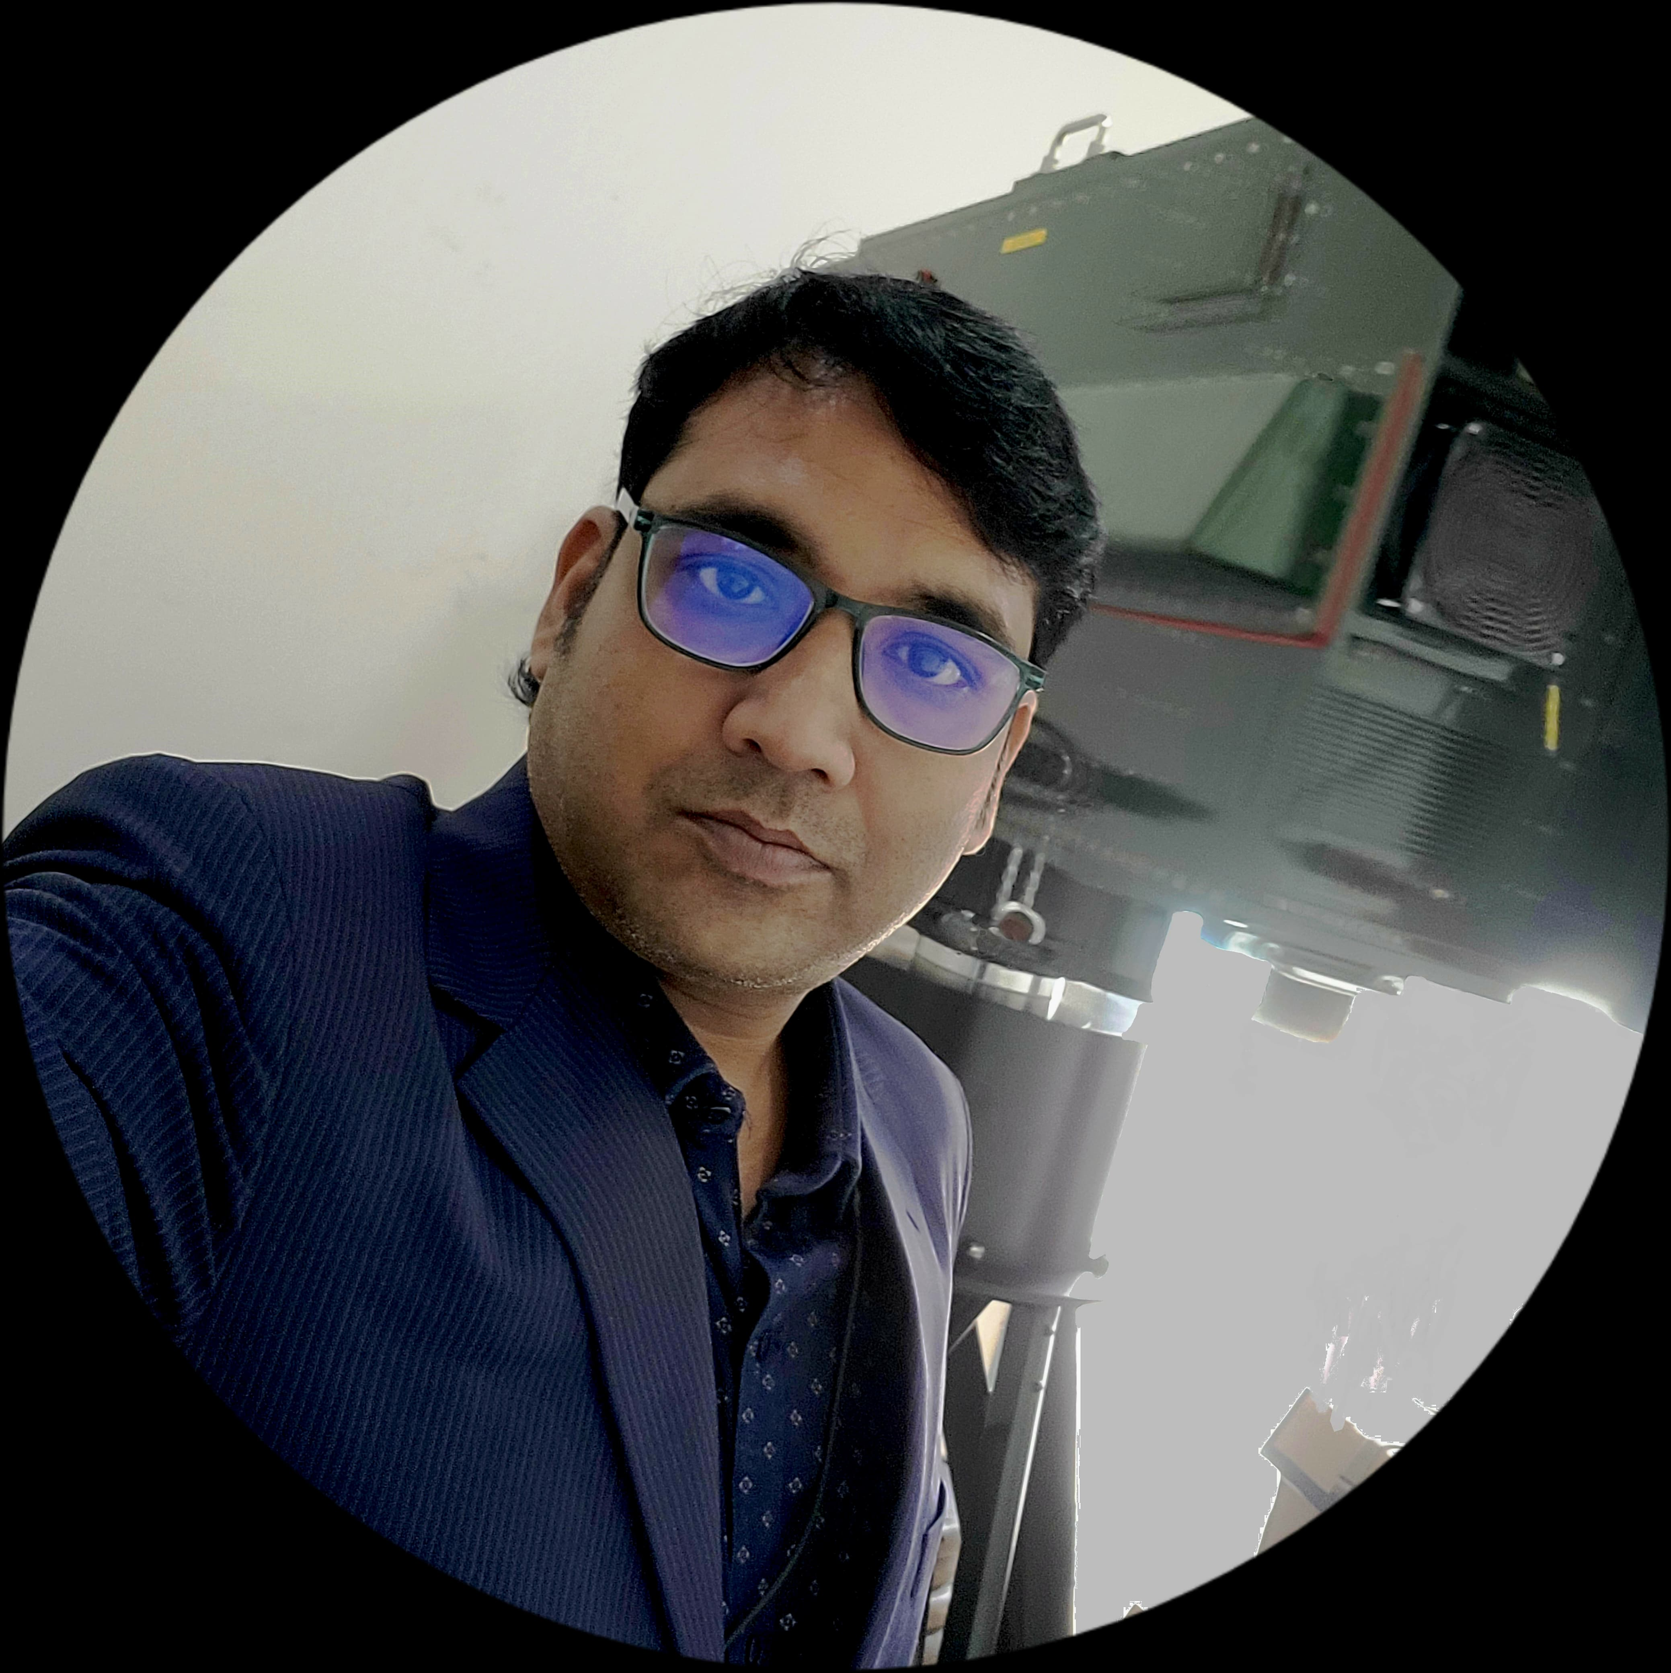
Prasenjit boral
PMP® Certified project Manager
Telecommunications | IP Network | Data Migration | Infrastructure Leader | Solution Architect
Bachelor of Technology (ECE) – West Bengal University of Technology

Slide 2
Executive Snapshot
  18+ years delivering Mission-Critical Excellence for Indian Armed Forces & PSUs.
  Accomplished PMP Certified Project Manager with 11+ years of exceptional expertise in spearheading transformative telecom and networking projects across global industries, defense, and government sectors.
  Renowned for adeptly managing complex operations while consistently meeting stringent deadlines and budget requirements.
  Visionary leader in strategizing and delivering comprehensive solutions, leveraging cutting-edge technologies to align with business objectives across B2B, B2C, and defense sectors.

Slide 3
collaborations
Defense: Indian Army, Indian Navy, BEL, GRSE, MDL, L&T
1
  Pioneering Project Manager
  Expertise encompasses prestigious partnerships
  Visionary leader in strategizing and executing end-to-end solutions
Telecom: BSNL, ITI Ltd, Airtel, Vodafone, Wipro
2
Global Telecom Giants: Cisco, Nortel, NovelSat, Nokia, Siemens, L3 Harris
3
Sectors: B2B, B2C, Defense, Government, State Police Force
4
Notes:
Trusted by National & Global Leaders

Slide 4
Key Discussion Points
Transforming Risks into Strategic Wins
Professional Summary
Leadership & Key Projects
Awards &
Recognition
1
3
5
7
2
4
6
8
Mastery Across Domains
Strategic Differentiation
Quantifiable Achievements
A Legacy of Precision

Slide 5



Professional Summary
Precision Electronics Ltd
Overall 18+ years expertise including 11+ years as Project Manager (PM) in driving complex full lifecycle projects in telecommunication & networking.
Skilled in delivering critical business milestones through strategic communication, adept negotiation, and robust risk mitigation.
ITI Ltd
Since Oct 2008
Secure Print Solutions
Jan 2007 – Oct 2008
Sep 2006 – Jan2007

Slide 6
Mastery Across Domains
  Project Management
  Telecom and Networking
  Cloud Services

Slide 7
Mastering Project Management
Risk Management
01
Time & Budget Management
02
Stakeholder Engagement
03
Cross Functional Team Management
04
Customer Relationship Management
05
06
End-to-End Project Delivery
Program Management
Waterfall
&
Agile
07
08
Microsoft Project
09

Slide 8
Telecom & Networking Mastery
IP Routing and Switching, Data Migration
1
2
Routing Protocols, MPLS, VoIP
Router, Switch, SDWAN, Server, MUX, Positioner
3
4
Data, Voice & Video over IP, Ethernet & ATM
GbE, TCP/IP, STM1, E1, Rs-422, RS-232
5
6
Python, Shell Scripting, HTML
Linux, Windows Server
7
8
Protocol Analyzer, Wireshark, Ethereal, TCPDump

Slide 9
Cloud Services Excellence
Azure Solution Architect
01
Migration from
On-Premises
to Azure Cloud
Block & Object Storage
05
02
04
03
Virtual Network
&
Computing
Load Balancing
&
Auto scaling
.

Slide 10

Leadership & Key Projects
Army Static Switched Communication Network (ASCON)
Client: Indian Army | Team size: 30+
Single and Dual Axis Positioner
Client: Indian Army | Team size: 15+
05
01
UHF Linking Equipment
Client: Indian Navy – Visakhapatnam (VDL), Kolkata (GRSE), and Mumbai (MDL) | Team size: 17+
ATM Based Integrated Ship-board Data Network
Client: Indian Navy – Visakhapatnam (VDL), Kolkata (GRSE), and Mumbai (MDL) | Team Size: 20+
04
02
03
P-to-M-P Ku-band Satellite Equipment (T-671)
Client: BSNL – Bangalore (Hub), Lakshadweep, Andaman and Nicobar Islands | Team Size: 20+

Slide 11

Quantifiable milestones Achieved
01
06
Increased Customer Acquisition by 40%
  Improved Project Delivery Times by 30%
  Reduced Project Risks by 40%
02
07
  Increased Team
  Productivity by 20%
  Improved Product NPS by 35%
03
08
Slashed design revisions by 30%
04
09
  Achieved 100% client satisfaction
  Secured ₹80+ Million AMC contracts post-delivery
05
10
Boosted on-time delivery rates by 25%
  Achieved 10% of extra profit of the main budget

Slide 12

Transforming Risks into Strategic Wins
Cross-Functional Conflict
(Positioner Project)
Situation: “Resource clash between engineers and vendors threatened ₹8 Cr deadlines.
Action: “Real-time role reallocation + Agile reprioritization workshops.”
Result: 2-weeks early delivery | 40% team morale boost.
Procurement & Production Risks (Ku-band Migration)
Situation: “OEM delays risked SLA penalties for BSNL.”
Action: “Dual sourcing + parallel workflow engineering.”
Result: 18% faster delivery | 10% cost savings.
01
Budget Overrun Prevention
(Positioner Project)
Situation: “Frequent scope changes by Indian Navy threatened ₹200 million budget.”
Action: “Stakeholder alignment matrix + phased approval gates.”
Result: 0% overrun | 100% compliance.
05
02
Union Engagement Risks
(AISDN Projects)
Situation: “Labor disputes halted Equipment fitting installations.”
Action: “Transparent negotiations + incentive-aligned KPIs.”
Result: Zero downtime | Equipments boarded and mounted on schedule.
Global OEM Integration
(Ku-band & AISDN Projects)
Situation: “Middle East/European OEMs resisted India-specific customizations.”
Action: “Co-development workshops aligning specs with local needs.”
Result: Faster approvals | 20% satisfaction increase.
04
03

Slide 13




A Legacy of Precision
Efficiency
02
Reliability
04
₹280 million Projects
Naval Commands PAN-India Sites
35% NPS Improvement
10% Profit Gain
100% Technical Compliance
0 Deadline Overruns
40% Risk Reduction
30% Faster Delivery
01
03
Scale
Growth

Slide 14






AWARDS &
RECOGNITION
Prasenjit's outstanding contributions and exemplary work have been recognized
by various prestigious awards and honors.
INNOVATOR
OF THE YEAR
OUTSTANDING
ACHIEVEMENT
EXCELLENCE
IN LEADERSHIP
PROFESSIONAL EXCELLENCE
IMPACTFUL
CHANGE MAKER
Best PM award

Slide 15
Strategic Differentiation – Why Partner With Me?
I don’t just manage projects – I future-proof them
Your Pain Points
My Value Proposition
40% Risk Reduction Frameworks
Uncontrolled Risks
Your
Challenges
My
Solutions
60+ Team Leadership Excellence
Cross-Functional Silos
SDWAN/Cloud-Native Architecture
Inefficient Tech Integration
Global-Local Misalignment
Battle-Tested OEM Negotiations

Slide 16
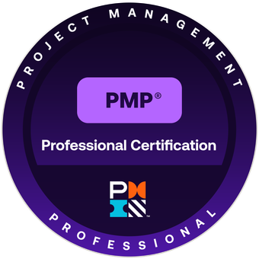



credentials & Closing : Validated Excellence
01
03
Project Management Professional (PMP)® – PMI
Credential ID: 3959265
Azure Administrator
Associate – Microsoft
Credential ID: F757709466EB215F
02
04
Azure Solutions Architect
Expert – Microsoft
Credential ID: 4E5297B58438CD64
Cloud Architect Master Program – Simplilearn
Credential ID: 116166838
Let’s Engineer Tomorrow’s Success
Ready to deploy a leader who turns complexity into clarity?

Slide 17
Thank you

